Slide 1

PHP – Introduction
Lecture 13
Asma Sajid
Asma Sajid: College of Computer Science & Information Studies, GCUF.

Slide 2
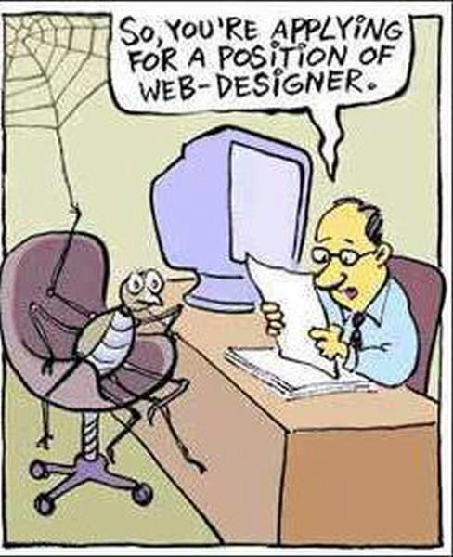
Caption it…

Slide 3
Introduction to PHP
PHP stands for PHP: Hypertext Preprocessor
• PHP is a server-side scripting language, like ASP
• PHP scripts are executed on the server
• PHP supports many databases (MySQL, Informix, Oracle, Sybase, Solid, PostgreSQL, Generic ODBC, etc.)
• PHP is an open source software
• PHP is free to download and use

Slide 4
PHP Files
PHP files can contain text, HTML tags and scripts
• PHP files are returned to the browser as plain HTML
• PHP files have a file extension of ".php", ".php3", or ".phtml"

Slide 5
History of PHP
PHP (PHP: Hypertext Preprocessor) was created by Rasmus Lerdorf in 1994. It was initially developed for HTTP usage logging and server-side form generation in Unix.
PHP 2 (1995) transformed the language into a Server-side embedded scripting language. Added database support, file uploads, variables, arrays, recursive functions, conditionals, iteration, regular expressions, etc.
PHP 3 (1998) added support for ODBC data sources, multiple platform support, email protocols (SNMP,IMAP), and new parser written by Zeev Suraski and Andi Gutmans .
PHP 4 (2000) became an independent component of the web server for added efficiency. The parser was renamed the Zend Engine. Many security features were added.
PHP 5 (2004) adds Zend Engine II with object oriented programming, robust XML support using the libxml2 library, SOAP extension for interoperability with Web Services, SQLite has been bundled with PHP

Slide 6
MySQL
MySQL is a database server
MySQL is ideal for both small and large applications
MySQL supports standard SQL
MySQL compiles on a number of platforms

Slide 7
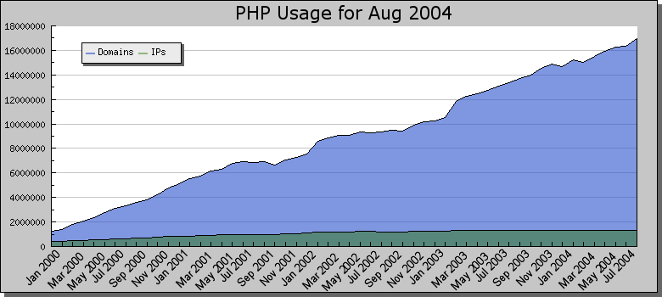
Brief History of PHP
As of August 2004, PHP is used on 16,946,328 Domains, 1,348,793 IP Addresses http://www.php.net/usage.php This is roughly 32% of all domains on the web.

Slide 8
PHP Installation
WampServer 2.0i for Windows platform Includes :
  - Apache 2.2.11
  - MySQL 5.1.36
  - PHP 5.3.0
http://www.wampserver.com/en/

Slide 9
PHP Syntax
Starts with <?php and ends with ?>.
A PHP scripting block can be placed anywhere in the document.
PHP file normally contains HTML tags.
Each code line in PHP must end with a semicolon.
Two basic statements to output text with PHP: echo and print.
file must have a .php extension.
use // to make a single-line comment or /* and */ to make a large comment

Slide 10
Why is PHP used?
Easy to Use
Code is embedded into HTML. The PHP code is enclosed in special start and end tags that allow you to jump into and out of "PHP mode".
<html>
<head>
<title>Example</title>
</head>
<body>
<?php
echo "Hi, I'm a PHP script!";
?>
</body>
</html>

Slide 11
Why is PHP used?
2. Cross Platform
Runs on almost any Web server on several operating systems.
One of the strongest features is the wide range of supported databases
Web Servers: Apache, Microsoft IIS, Caudium, Netscape Enterprise Server
Operating Systems: UNIX (HP-UX,OpenBSD,Solaris,Linux), Mac OSX, Windows NT/98/2000/XP/2003
Supported Databases: Adabas D, dBase,Empress, FilePro (read-only), Hyperwave,IBM DB2, Informix, Ingres, InterBase, FrontBase, mSQL, Direct MS-SQL, MySQL, ODBC, Oracle (OCI7 and OCI8), Ovrimos, PostgreSQL, SQLite, Solid, Sybase, Velocis,Unix dbm

Slide 12
3. Cost Benefits
PHP is free. Open source code means that the entire PHP community will contribute towards bug fixes. There are several add-on technologies (libraries) for PHP that are also free.

Slide 13
Getting Started
How to escape from HTML and enter PHP mode
PHP parses a file by looking for one of the special tags that
tells it to start interpreting the text as PHP code. The parser then executes all of the code it finds until it runs into a PHP closing tag.
HTML
PHP CODE
HTML
<?php echo “Hello World”; ?>
Starting tag | Ending tag | Notes
<?php | ?> | Preferred method as it allows the use of PHP with XHTML
<? | ?> | Not recommended. Easier to type, but has to be enabled and may conflict with XML
<script language="php"> | ?> | Always available, best if used when FrontPage is the HTML editor
<% | %> | Not recommended. ASP tags support was added in 3.0.4

Slide 14
Getting Started
Simple HTML Page with PHP
The following is a basic example to output text using
PHP.
<html><head> <title>My First PHP Page</title> </head> <body> <?php echo "Hello World!"; ?> </body></html>
Copy the code onto your web server and save it as “test.php”.
You should see “Hello World!” displayed.
Notice that the semicolon is used at the end of each line of PHP code to signify a line break. Like HTML, PHP ignores whitespace
between lines of code. (An HTML equivalent is <BR>)

Slide 15
Variables in PHP
All variables in PHP start with a $ sign symbol.
The correct way of declaring a variable in PHP:
$var_name = value;
In PHP, a variable does not need to be declared before adding a value to it .
Data type is not needed.
<?php
$txt="Hello World!"; $x=16;
?>

Slide 16
Naming Rules
A variable name must start with a letter or an underscore "_"
A variable name can only contain alpha-numeric characters and underscores (a-z, A-Z, 0-9, and _ ).
A variable name should not contain spaces.
If a variable name is more than one word, it should be separated with an underscore ($my_string), or with capitalization ($myString)

Slide 17
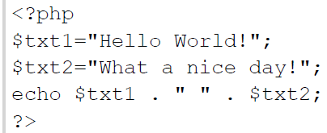
Concatenation Operator
There is only one string operator in PHP.
The concatenation operator (.) is used to put two string values together.
To concatenate two string variables together, use the concatenation operator:

Slide 18
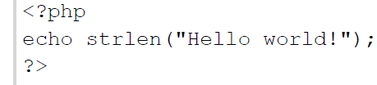
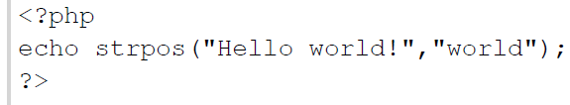
String Functions
The strlen() function is used to return the length of a string.
strpos() function is used to search for character within a string.
  If a match is found, this function will return the position of the first match. If no match is found, it will return FALSE.

Slide 19
Operators
Arithmetic
Logical
Relational
Assignment

Slide 20
Conditional Stmts: If - else
In PHP we have the following conditional statements:
• if statement - use this statement to execute some code only if a specified condition is true
• if...else statement - use this statement to execute some code if a condition is true and another code if the condition is false
• if...elseif....else statement - use this statement to select one of several blocks of code to be executed
• switch statement - use this statement to select one of many blocks of code to be executed

Slide 21
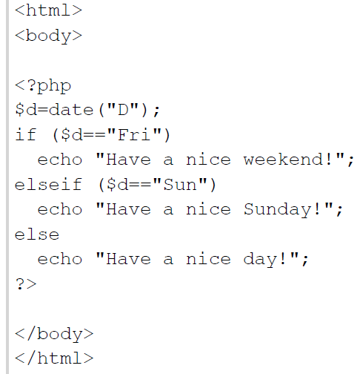
Example 1: if-else-if

Slide 22
Example 2: Switch Statement
<html>
<body>
<?php
switch ($x) {
case 1: echo "Number 1"; break;
case 2: echo "Number 2"; break;
case 3: echo "Number 3"; break;
default: echo "No number between 1 and 3";
}
?>
</body> </html>

Slide 23
PHP Arrays
An array stores multiple values in one single variable.
$cars1="Saab";
$cars2="Volvo";
$cars3="BMW";
An array can hold all your variable values under a single name. And you can access the values by referring to the array name.
Each element in the array has its own index so that it can be easily accessed.
TYPES OF ARRAYS:
In PHP, there are three kind of arrays:
  Numeric array - An array with a numeric index
  Associative array - An array where each ID key is associated with a value.
  Multidimensional array - An array containing one or more arrays

Slide 24
Numeric Arrays
A numeric array stores each array element with a numeric index.
There are two methods to create a numeric array.
  $city=array(“isb",“fsd",“lhr",“khi");
  $city[0]=“isb";
  $city[1]=“fsd";
  $city[2]=“lhr";
  $city[3]=“khi";

Slide 25
Associative Arrays
An associative array, each ID key is associated with a value.
When storing data about specific named values, a numerical array is not always the best way to do it.
With associative arrays we can use the values as keys and assign values to them.
we use an array to assign ages to the different persons:
$ages = array("Peter"=>32, "Quagmire"=>30, "Joe"=>34);

Slide 26
Associative Arrays
$ages['Peter'] = "32";
$ages['Quagmire'] = "30";
$ages['Joe'] = "34";
The ID keys can be used in a script:
  <?php
  $ages['Peter'] = "32";
  $ages['Quagmire'] = "30";
  $ages['Joe'] = "34";
  echo "Peter is " . $ages['Peter'] . " years old.";
  ?>

Slide 27
Multidimensional Arrays
In a multidimensional array, each element in the main array can also be an array. And each element in the sub-array can be an array, and so on.
  $families = array
  (
  "Griffin"=>array
  (
  "Peter",
  "Lois",
  "Megan"
  ),
  "Quagmire"=>array
  (
  "Glenn"
  ),
  "Brown"=>array
  (
  "Cleveland",
  "Loretta",
  "Junior"
  )
  );

Slide 28
Multidimensional Arrays
Array
(
[Griffin] => Array
(
[0] => Peter
[1] => Lois
[2] => Megan
)
[Quagmire] => Array
(
[0] => Glenn
)
[Brown] => Array
(
[0] => Cleveland
[1] => Loretta
[2] => Junior
)
)

Slide 29
PHP Looping
Loops execute a block of code a specified number of times, or while a specified condition is true.
Often when you write code, you want the same block of code to run over and over again in a row. Instead of adding several almost equal lines in a script we can use loops to perform a task like this.
In PHP, we have the following looping statements:
  while - loops through a block of code while a specified condition is true
  do...while - loops through a block of code once, and then repeats the loop as long as a specified condition is true
  for - loops through a block of code a specified number of times
  foreach - loops through a block of code for each element in an array

Slide 30
The while Loop
The while loop executes a block of code while a condition is true.
Syntax
  while (condition)
  {
  code to be executed;
  }
Example:
  <html>
  <body>
  <?php
  $i=1;
  while($i<=5)
  {
  echo "The number is " . $i . "<br />";
  $i++;
  }
  ?>
  </body></html>

Slide 31
The do...while Statement
The do...while statement will always execute the block of code once, it will then check the condition, and repeat the loop while the condition is true.
Syntax
  do
  {
  code to be executed;
  }
  while (condition);
Example:
  <html>
  <body>
  <?php
  $i=1;
  do
  {
  $i++;
  echo "The number is " . $i . "<br />";
  }
  while ($i<=5);
  ?>
  </body>
  </html>

Slide 32
For Loops
The for statement is used when you know how many times you want to execute a statement or a list of statements.
Syntax
  for (init; condition; increment)
  {
  code to be executed;
  }
<html>
<body>
<?php
for ($i=1; $i<=4; $i++)
{
echo "The number is " . $i . "<br />";
}
?>
</body>
</html>

Slide 33
LAB TASK 9
Show this menu on web page and use different colors for each option of meals.
Calculate gross bill and net bill.
Keep taking input choice for meals from user until user presses zero.
When zero is pressed, net bill should be displayed on screen.
If value of gross bill is >=200 then tax will be 5% of the total bill.
If the gross bill is greater than or equal to 500 then tax rate will be 10%.
If gross bill is >=800 then tax will be 15%.
If this value gets raised by 1200 or more then tax will be 20%.
Note:
Net_Bill= Gross_Bill+Tax
Where as Tax=meal_amount*Tax_rate/100
Menu
Sr # | Name | Price
1 | Lunch Deal 1 | 200
2 | Lunch Deal 2 | 300
3 | Dinner 1 | 600
4 | Dinner 2 | 800
5 | Addons | 100

